Slide 1
Python for Everybody
Utilizing DataCamp Light for interactive lessons

Slide 2

Client/Client Needs
Dr. Harold Nelson
Needs supplemental material for an introductory programming class

Slide 3
Challenges
Skill level of incoming students
Preparing students for future Saint Martin’s programming requirements
Submission Correctness Test (SCT) Syntax
Robust and helpful tests and feedback
Time management and balancing school load

Slide 4
Process:
Generating material outlines
Using material outline to create course progression/ blueprints
Establish Learning Objectives as guidelines
Creating material and problems
Accurate solution testing (SCT)
Apply course to the classroom
https://instructor-support.datacamp.com/courses

Slide 5
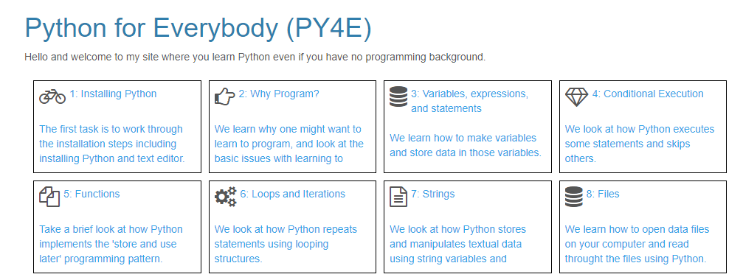
Item | Scheduled Due Date
Module 1: Brief Intro to Python & DataCamp | Week 1: 8/26 – 8/30
Module 2: Variables, Expressions and Statements | Weeks 2 & 3: 9/2 – 9/13
Module 3: Conditional Execution | Weeks 4 & 5: 9/16 – 9/27
Module 4: Functions | Weeks 6 & 7: 9/30 – 10/11
Intermediate Presentation | Weeks 8 & 9: 10/14 – 10/25
Module 5: Iteration | Weeks 10 & 11: 10/28 – 11/8
Module 6: Strings | Weeks 11 & 12: 11/11 – 11/22
Module 7: Files | Weeks 13 & 14: 11/25 – 12/6
Final Presentation | Week 15 (Finals): 12/9 – 12/12

Slide 6
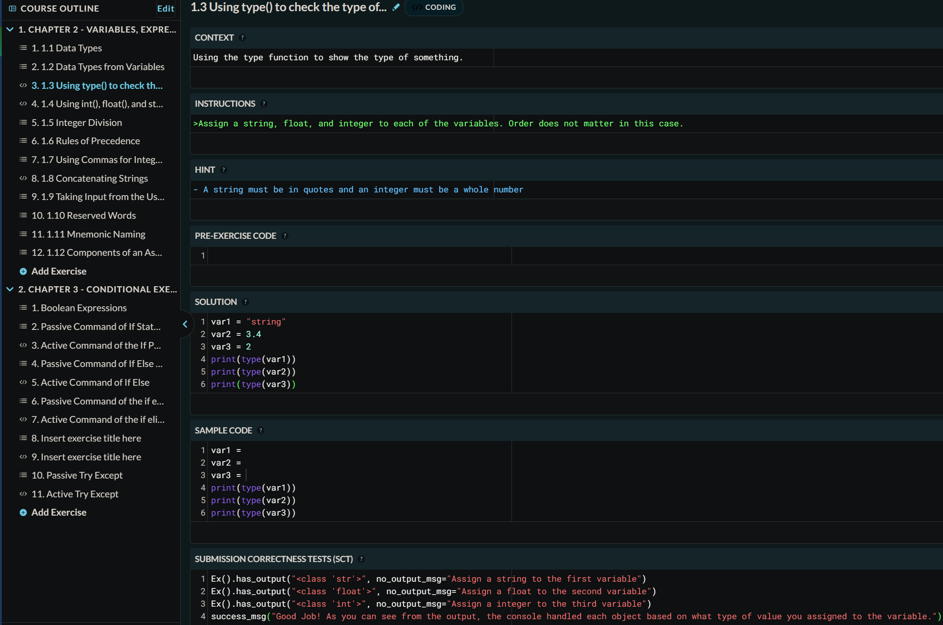
Main Technological Features

